Slide 1
fastest finger first indicator
GROUP NO:10
KANZAL HAQ - 4NM20EE032
PRATHAM - 4NM20EE055
RUHBAN -4NM20EE011
CHANDAN B -4NM20EE013
RAGHAVENDRA Y R - 4NM20EE060
AJITH KUMAR A - 4NM20EE002

Slide 2
components
IC 7085
IC 7475
IC 7420
IC 74147
RESISTORS(Required range)
PUSH SWITCHES
7 SEGMENT LED DISPLAY (LT542)

Slide 3
WHY IT IS USED….
The kit fastest finger first quiz-type game shows are increasingly becoming popular on television these days. In such games, fastest finger first indicators (FFFIs) are used to test the player's reaction time. The player's designated number is displayed with an audio alarm when the player presses his entry button.
IF THERE IS A FOUR CONTESTANT ,THE CIRCUIT DETERMINES AS TO WHICH OF THE FOUR CONTESTANT FIRST PRESSED THE BUTTON AND LOCKS OUT THE REMAINING THREE ENTRIES. THE CORRECT DECIMAL NUMBER DISPLAY OF THE CORRESPONDING CONTESTANT ARE ACTIVATED

Slide 4
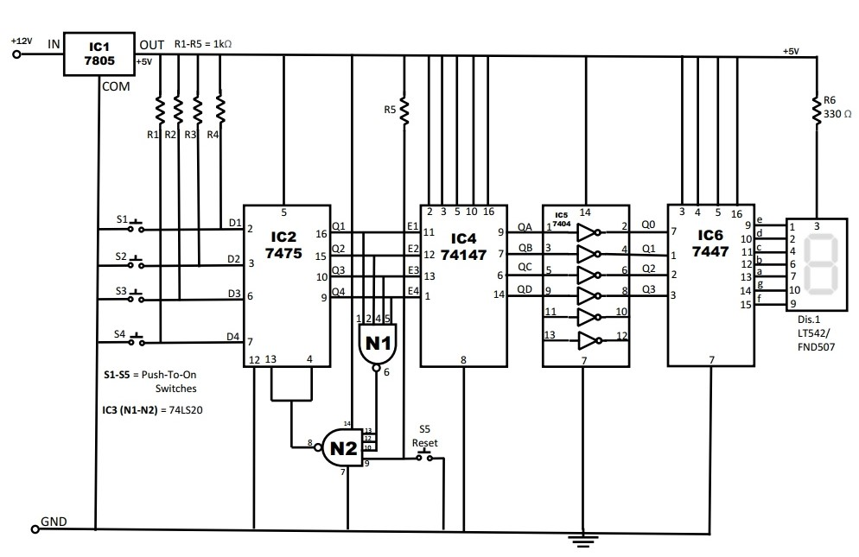

Circuit diagram…

Slide 5
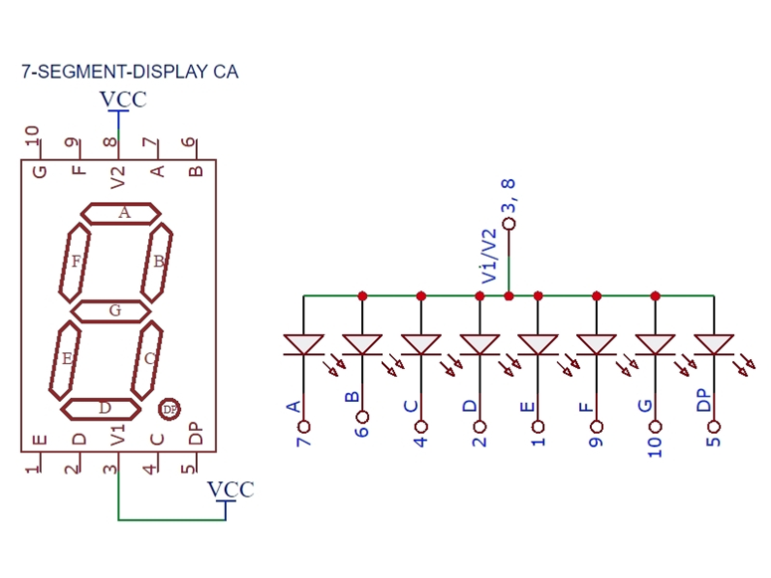

Slide 6
Working…
Quiz-type game shows are increasingly becoming popular on television these days. In such games, fastest finger first indicators (FFFIs) are used to test the player’s reaction time. The player’s designated number is displayed with an audio alarm when the player presses his entry button.
The circuit presented here determines as to which of the four contestants first pressed the button and locks out the remaining three entries. Simultaneously, an audio alarm and the correct decimal number display of the corresponding contestant are activated.
When a contestant presses his switch, the corresponding output of latch IC2 (7475) changes its logic state from 1 to 0. The combinational circuitry comprising dual 4-input NAND gates of IC3 (7420) locks out subsequent entries by producing the appropriate latch-disable signal.
Priority encoder IC4 (74147) encodes the active-low input condition into the corresponding binary coded decimal (BCD) number output. The outputs of IC4 after inversion by inverter gates inside hex inverter 74LS04 (IC5) are coupled to BCD to- 7-segment decoder/display driver IC6 (7447). The output of IC6 drives common anode 7-segment LED display (DIS.1, FND507 or LT542).
IC7 needs +12V DC supply for sufficient alarm level. The remaining circuit operates on regulated +5V DC supply, which is obtained using IC1 (7805).
Once the organizer identifies the contestant who pressed the switch first, he forces the digital display to ‘0’ by pressing reset push button S5.

Slide 7
Thank you

